Slide 1



Slide 2

Feature Selection
https://medium.com/@mehulved1503/feature-selection-and-feature-extraction-in-machine-learning-an-overview-57891c595e96
Notes:
to get improved accuracy with decreased training time
you keep your interpretable features (no abstract PCA components)
Three key benefits of performing feature selection on your data are:
Reduces Overfitting: Less redundant data means less opportunity to make decisions based on noise.
Improves Accuracy: Less misleading data means modeling accuracy improves.
Reduces Training Time: Less data means that algorithms train faster.

Slide 3
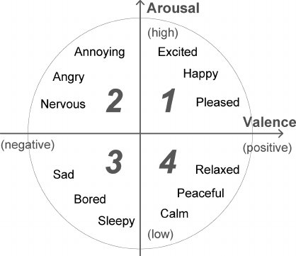
Affective Computing
Expression
relationship with affective states and observable tendencies
Embodiment
relationship between affective states and physiological symptoms
Neuroscience
affective neuroscience
Arousal-valence
deconstruction of emotional states into arousal vs valence (2D scale)
2D valence-arousal emotion space (Russell 1980)

Slide 4
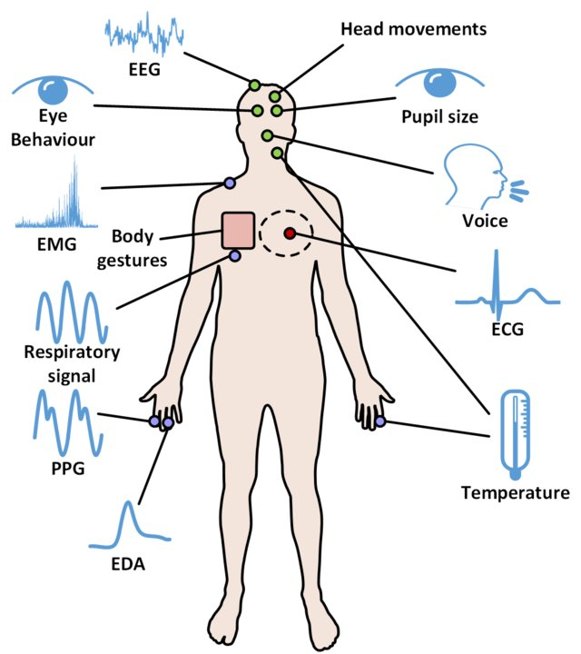
Embodiment
Use of physiological signals for emotion recognition
Multimodal measurements possible
E.g. EMG, ECG, skin conductance and respiration rate
→ But what are the critical features?
Review on psychological stress detection using biosignals - Giannakakis et al. 2019

Slide 5
Classification of Pain intensities

Slide 6

Issues of prior pain classification studies
Focus on particular modality → might not apply to other modalities
No feature selection method applied → unknown source of enhancements or: Feature selection only works for specific study → does not generalize
Subject-dependent feature selection → source of improvement linked to subject info?
Not only accuracy matters!

Slide 7
Aim of this study
obtain meaningful, discriminatory and generalizable features for pain recognition studies
quantify associations between modalities and features

Slide 8
Materials and Methods

Slide 9
Emotion Data
Data: Heat Pain Database
surface EMG (zygomaticus, corrugator, trapezius muscles)
ECG
SCL
heat/pain stimulus at different intensities → physiological measures recorded
Baseline (32°), pain threshold and pain tolerance defined for each subject
four classification problems
(1) pain threshold problem (B vs. T1),
(2) pain tolerance problem (B vs. T4),
(3) three-class problem (B vs. T1 vs. T4),
(4) five-class problem (B vs. T1 vs. T2 vs. T3 vs. T4).
Notes:
pain threshold: detect: pain tolerance: highest possible

Slide 10


Feature selection
We want to train a classifier to predict pain levels
We need to pick features

Slide 11
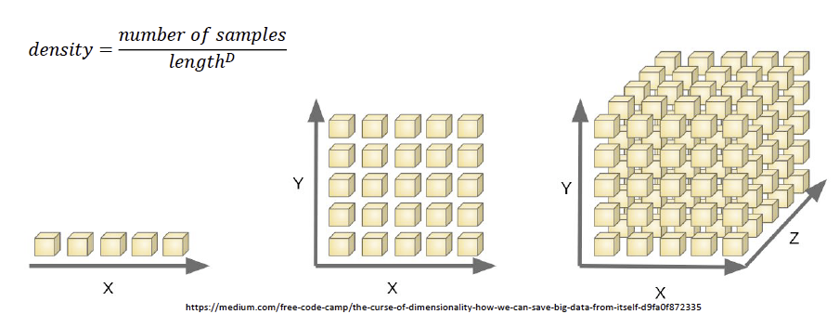
Inputs that do not carry information can lead to bad performing models
Solution:
More data
Robust models
Dimensionality reduction - find a subspace that consists of important features only (PCA / ICA)
Feature selection

Slide 12
Data collection
pre-processing
feature extraction
feature selection
classification
Biopotential and Video Heat Pain Database (Gruss, 2015)
Data includes:
EMG (zygomaticus, currugator, trapezius)
ECG
SCL
Randomly selected heat stimuli (4s) followed by 5.5s recording Baseline + 4 heat-pain levels

Slide 13
Data collection
pre-processing
feature extraction
feature selection
classification
Artifact removal:
Bandpass filtering
Powerline noise removal
Data segmentation
Z-scoring

Slide 14
Data collection
pre-processing
feature extraction
feature selection
classification
Feature extraction:
“Process of increasing information density by retrieving key properties from a larger element of data.”
Extracted features:
Time domain features - information directly from the time series
Frequency domain features - calculated from transformed data(e.g. phasic component in SCL)
Notes:
Frequency domain features calculated form transformed data and involve a characterisation from the spectral domain. (e.g. phasic component of SCL shown to be correlated with arousal)

Slide 15
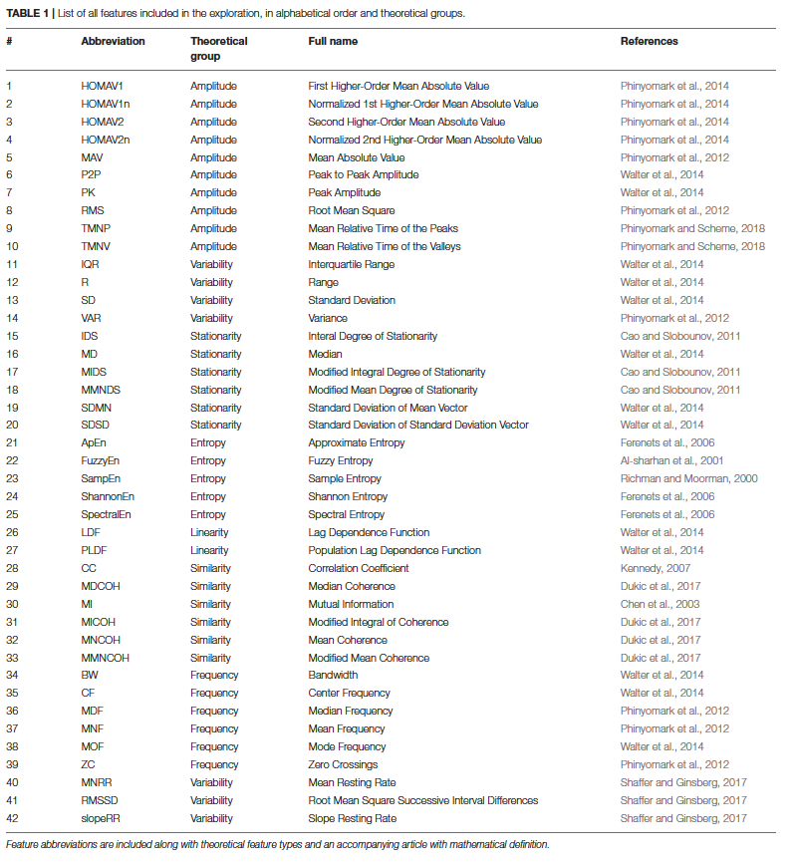
Beautiful large list with
155 potential features

Slide 16
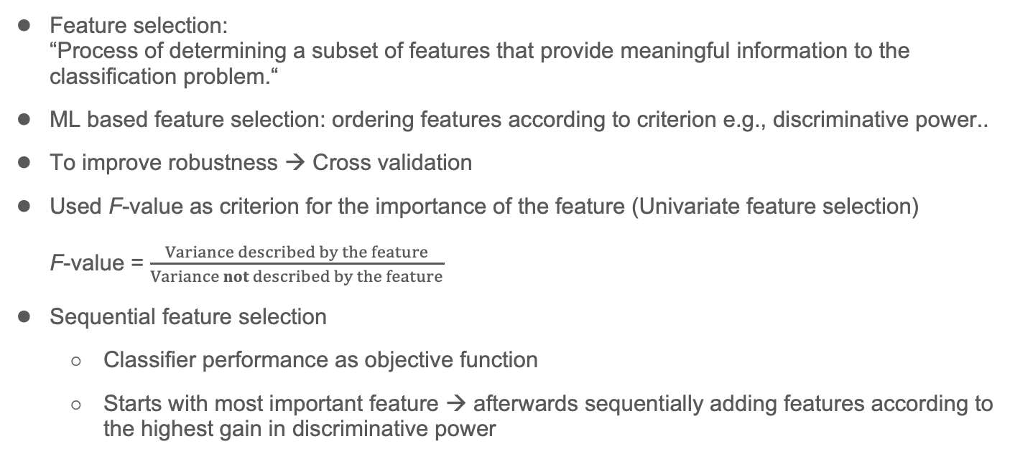
Data collection
pre-processing
feature extraction
feature selection
classification
Machine learning-based
feature selection involves ordering a set of features based on some
criterion, such as discriminative power.Once ranked, features are
incrementally and iteratively added to the classification model
until some desired threshold was met.

Slide 17
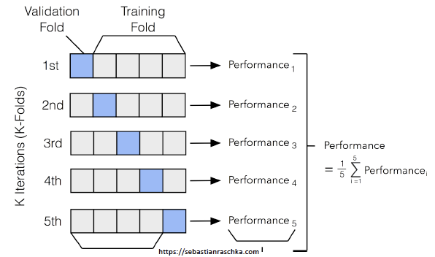
Cross-validation

Slide 18
Data collection
pre-processing
feature extraction
feature selection
classification
Machine learning-based
feature selection involves ordering a set of features based on some
criterion, such as discriminative power.Once ranked, features are
incrementally and iteratively added to the classification model
until some desired threshold was met.
The F-value for each feature was determined
through a one-way ANOVA. The features were then ranked
according to their mean F-value determined from the feature
selection train set of each CV.

Slide 19
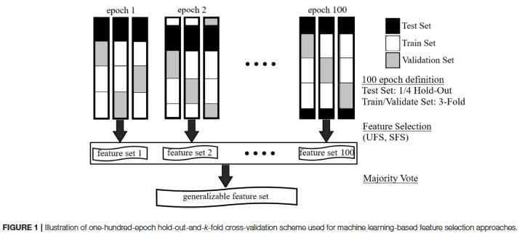

Slide 20
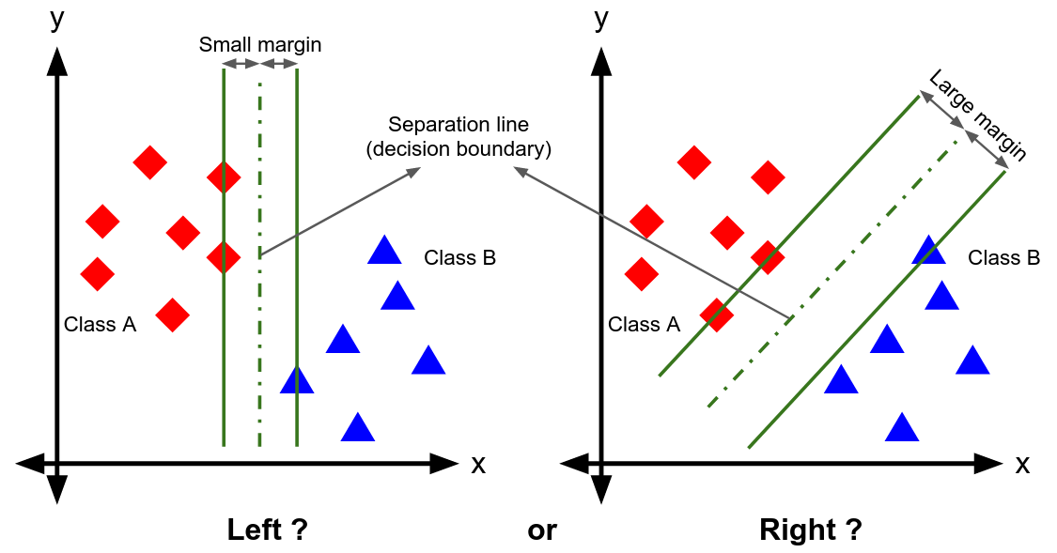
Data collection
pre-processing
feature extraction
feature selection
classification
Feature selection protocols repeated for each of the four classification problems
SVM classifiers were trained using feature sets (linear kernels 1 vs. 1 strategy)
Number of features determined by local and global maximum
- Local maximum = adding another feature does not generate a significant improvement in performance - Global maximum = upper performance limit of classifier
--> corresponding number of features -low = information is dense and only in few features;
-high = information spread across features
Machine learning-based
feature selection involves ordering a set of features based on some
criterion, such as discriminative power.Once ranked, features are
incrementally and iteratively added to the classification model
until some desired threshold was met.

Slide 21
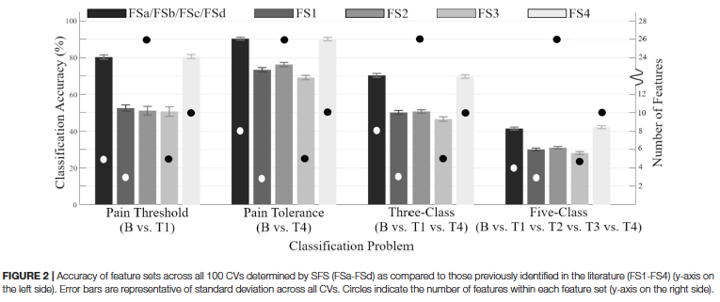

Slide 22
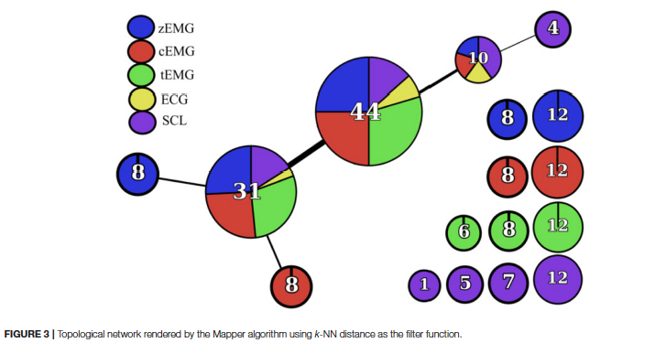
Topological data analysis (TDA)
Mapper produces controlled simplifications based on similarity or metric characteristics.
Projecting high dimensional data into lower dimensional space while preserving associations
Assumption: Features with similar definitions characterize the same information and are thus grouped together.

Slide 23


Slide 24
Discussion

Slide 25
Identification of General Discriminative Feature Sets
Difference between UFS (72.9% accuracy) and SFS (90.3% accuracy) (B vs T4)!
→ due to early local maximum in USF (reaching stop criteria)?
→ differences in sensitivity to correlation between features → SFS ≠ UFS feature sets
UFS: findings are applied classification task, not optimized to specific classifier
SFS: less affected by correlation between features
solution for UFS: define threshold of max correlation between features - but where?
Notes:
The purpose of UFS was to verify the discriminative power of
each feature in isolation, whereas SFS assesses discriminative
power in the presence and context of other features. Largely,
the features selected by UFS had strong correlation to one
another, as no restriction for similar features was imposed.
generally, SFS performed better

Slide 26
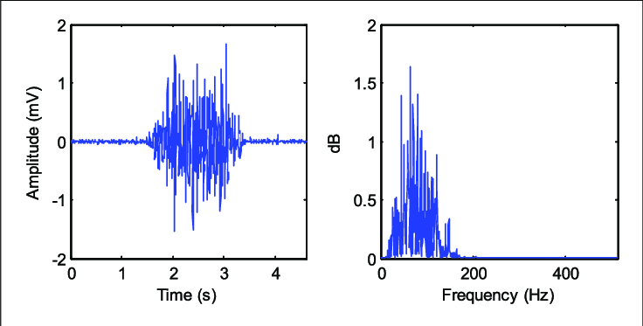
5 empirically determined Functional Feature Groups
“cross-modal” nodes based on type of information
functional groups > theoretical groups:
→ information > designed purpose
e.g. EMG recording:
→ 0 -mean behaviour
→ variance ~= amplitude (different purpose, functionally similar)
→ identification of new features: segment data to freq. bands or apply FTT before feature selection
Wu et al. 2017 Frontiers in Neuroscience
Notes:
→ e.g. MEG recording over longer period will show 0 -mean behaviour, so that variance = the actual signal and thus also represents amplitude (different purpose, functionally similar) → could segment data or apply FTT before feature selection

Slide 27
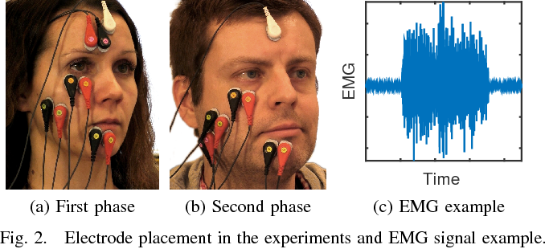
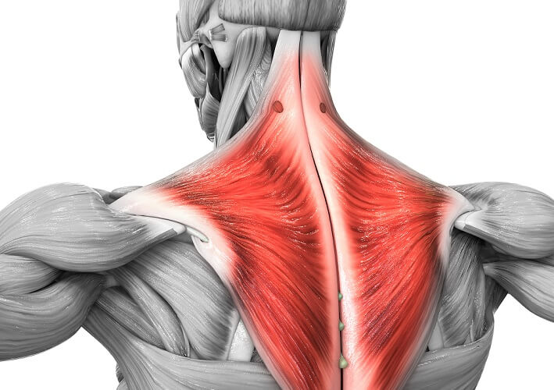
Physiological plausibility of extracted features
SAP features of facial and trapezius muscle activity link to pain → sympathetic arousal and stress
contrasting evidence - different sampling frequencies?
EMG CC & pain
→ repeatable autonomic excitation
→ sympathetic response influenced by mental state?
mood change influences reliability of EMG CC
Weak & negative link between ECG and pain!
→ pain stimulation lead to parasympathetic activity!
large exhale at pain occurence?
Figure source: https://www.semanticscholar.org/paper/A-survey-on-the-feasibility-of-surface-EMG-in-Rantanen-Ilves/5b725822ab161d1eb13fc818e91f900cf4599929/figure/1
Notes:
different sampling frequencies in facial EMG compared to EMG in other muscles of the body
EMG cc = correlation coefficient

Slide 28
Group discussion
Feature selection vs dimensionality reduction - what’s better?

Slide 29
Thank you
for your attention!

Slide 30
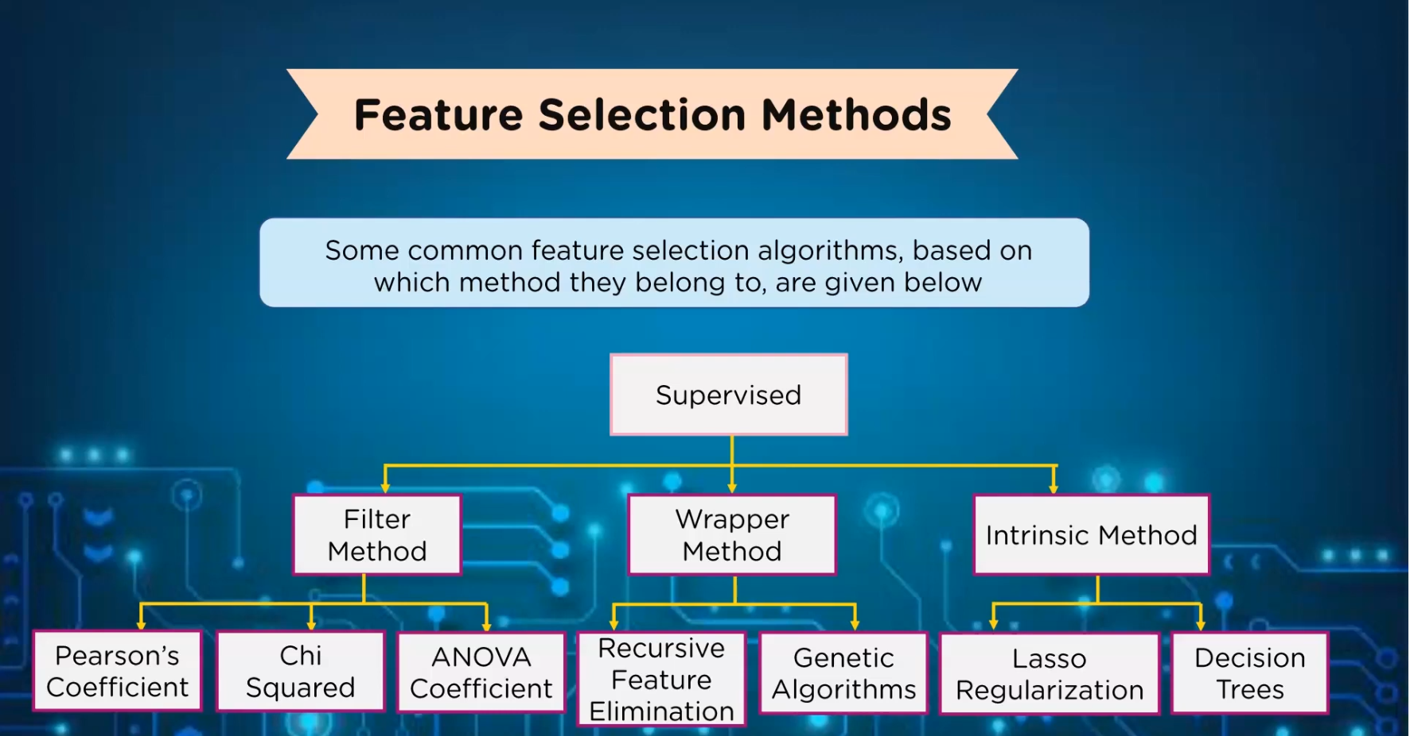
Extra slide

